Slide 1
PROJECT CHARTER
IT Project Management Foundation

Slide 2
What is a Project charter?
Definition: A project charter is a document developed and agreed upon in consultation with stakeholders to formally authorize the undertaking of a project.
Contents of a project charter:
  Project title
  Project duration (start and end date)
  Budget information
  Name and contacts of project manager
  Project objectives and scope
  Project success criteria
  Roles and responsibilities
  Signatures of stakeholders
  Comments/opinion of stakeholders (where necessary)
  See pg. 98 of the course book

Slide 3
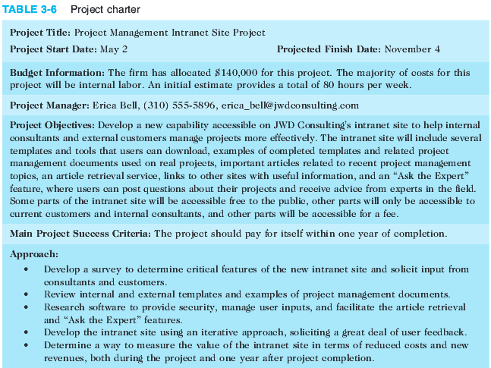
Project Charter Docuemnt: Sample

Slide 4
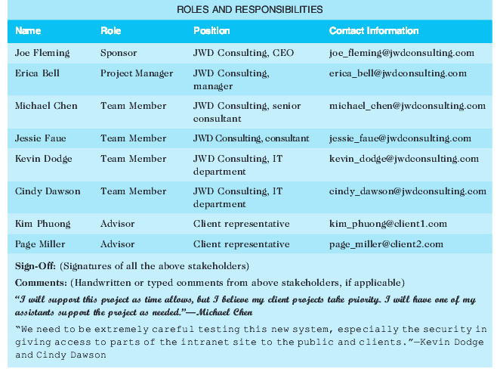
Project Charter : Sample Cont’d

Slide 5
        End!

